Slide 1
CHAPTER 5
Diffusion
Outline
Diffusion mechanisms
  Vacancy diffusion
  Interstitial diffusion
  Impurities
Mathematics of diffusion
  Steady-state diffusion (Fick’s first law)
  Nonsteady-State Diffusion (Fick’s second law)
Factors that influence diffusion
  Diffusing species
  Host solid
  Temperature
  Microstructure

Slide 2
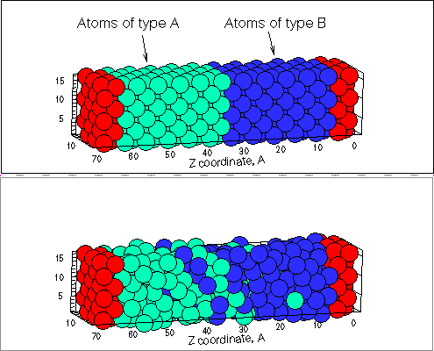
What is diffusion?
Diffusion→ transport by atomic motion.
Inhomogeneous material can become homogeneous by diffusion. Temperature should be high enough to overcome energy barrier.

Slide 3
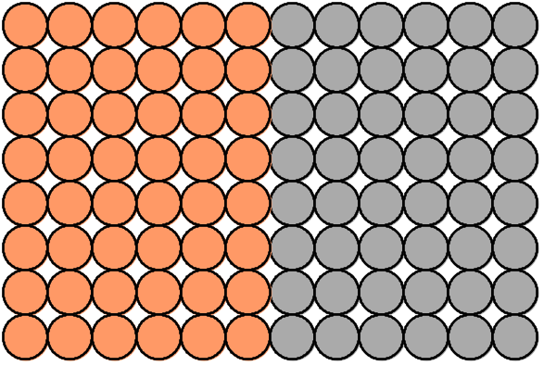
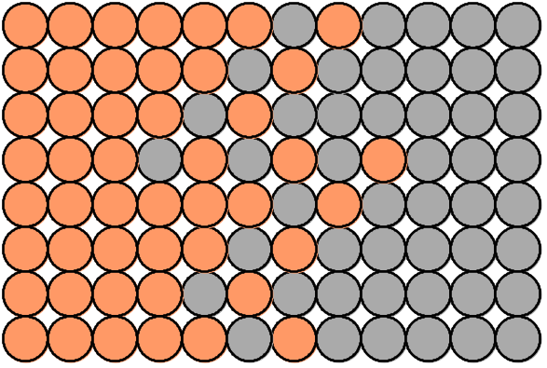
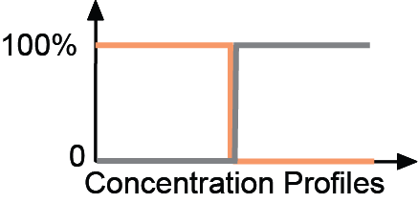
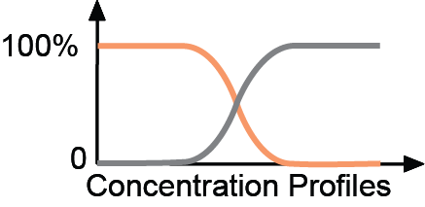
Interdiffusion: In an alloy, atoms tend to migrate from
regions of high conc. to regions of low conc.
Concentration Gradient → Interdiffusion (or Impurity Diffusion).
Initially
After some time

Slide 4
Self-diffusion:
one-component material, atoms are of same type.
Label some atoms
After some time
C
C
A
D
A
D
B
B

Slide 5
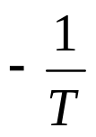

Mechanisms
Two for metallic diffusion
① vacancy diffusion
V ←→ Atom
exchange
depend upon [v] conc. ( exp( ) )
② interstitial
• atoms ( impurities ) are small enough to fit in
interstitial site.

Slide 6
To jump from lattice site to lattice site, atoms need energy to break bonds with neighbors, and to cause the necessary lattice distortions during jump.
Therefore, there is an energy barrier.
Energy comes from thermal energy of atomic vibrations (E_{av} ~ kT)
Atom flow is opposite to vacancy flow direction.

Slide 7
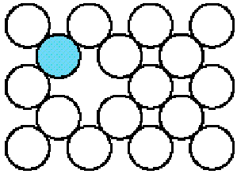
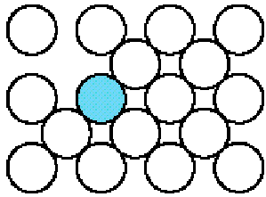
Diffusion Mechanisms
Vacancy diffusion
Atom migration
Vacancy migration
Before
After

Slide 8

Interstitial diffusion
Interstitial atom
before diffusion
Interstitial atom
after diffusion
Generally faster than vacancy diffusion because bonding of interstitials to surrounding atoms is normally weaker and there are more interstitial sites than vacancy sites to jump to.
Smaller energy barrier
Only small impurity atoms (e.g. C, H, O) fit into interstitial sites.

Slide 9
Flux of diffusing atoms, J.
Number of atoms diffusing through unit area per unit time [atoms/(m²s)]
or
Mass of atoms diffusing through unit area per unit time [kg/(m² s)]
J
A
Mass: J = M / (A t) ≅ (1/A) (dM/dt)

Slide 10
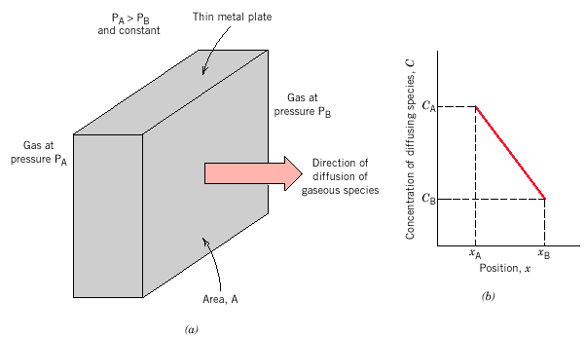
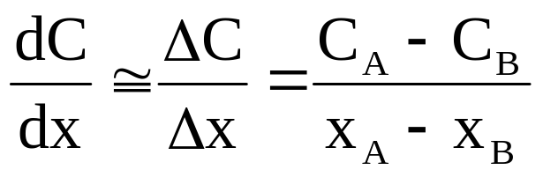
Steady-State Diffusion
Diffusion flux does not change with time
Concentration profile:
Concentration (kg/m³) vs. position
Concentration gradient: dC/dx (kg / m⁴)

Slide 11
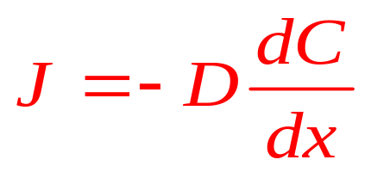
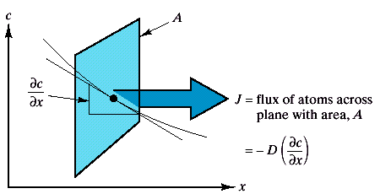
Steady-State Diffusion
Fick’s first law: J proportion to dC/dx
D=diffusion coefficient
Concentration gradient is ‘driving force’
Minus sign means diffusion is ‘downhill’: toward lower concentrations

Slide 12
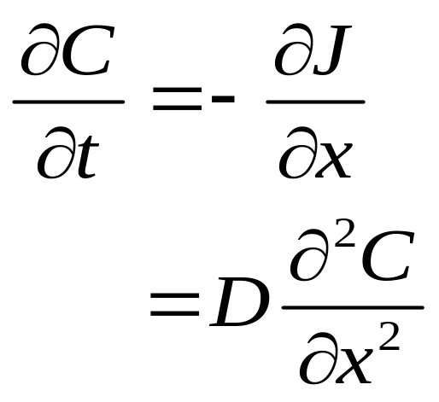
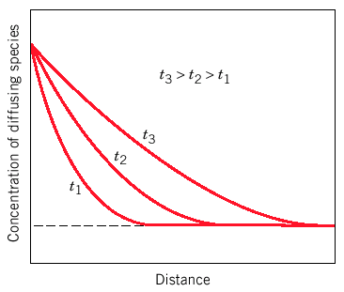
Nonsteady-State Diffusion
Concentration changing with time
Fick’s second law
Find C(x,t)

Slide 13
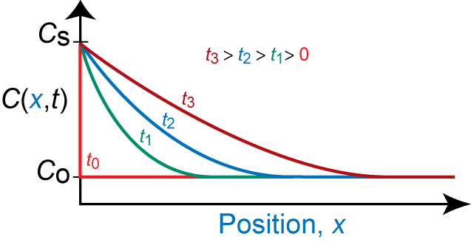
C
s
at t = 0, C = C_{o} for 0 ≤ x ≤ ∞
at t > 0, C = C_{S} for x = 0 (const. surf. conc.)
C = C_{o} for x = ∞

Slide 14
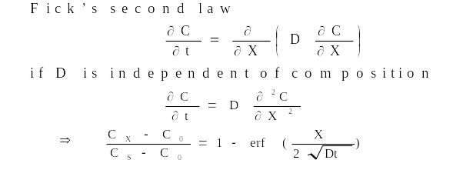
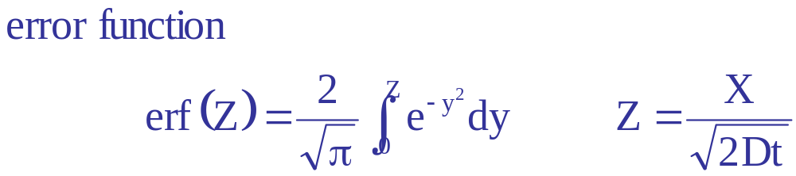
Gaussian error function

Slide 15
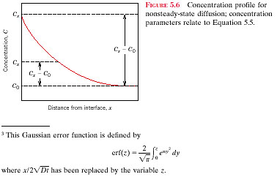
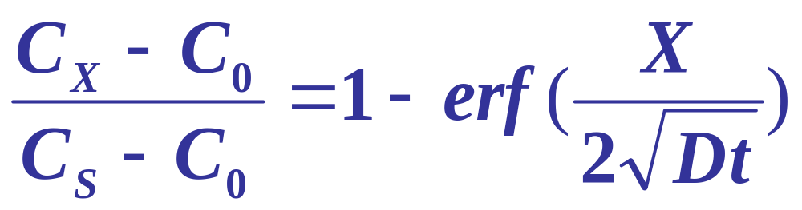
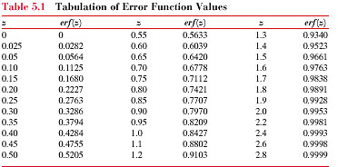
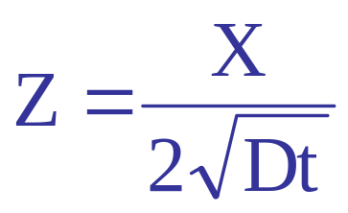
C_{S}
X

Slide 16
For some applications, it is necessary to harden the surface of a steel (or iron-carbon alloy) above that of its interior. One way this may be accomplished is by increasing the surface concentration of carbon in a process termed carburizing; the steel piece is exposed, at an elevated temperature, to an atmosphere rich in a hydrocarbon gas, such as methane (CH₄).
Consider one such alloy that initially has a uniform carbon concentration of 0.25 wt% and is to be treated at 950 ºC. If the concentration of carbon at the surface is suddenly brought to and maintained at 1.2wt.%, how long will it take to achieve a carbon content of 0.8wt% at a position 0.5 mm below the surface? The diffusion coefficient for carbon in iron at this temperature is 1.6x10⁻¹¹ m²/s; assume that the steel piece is semi-infinite.

Slide 17
The diffusion coefficients for copper in aluminum at 500 and 600 ºC are 4.8x10⁻¹⁴ and 5.3x10⁻¹³ m²/s, respectively. Determine the approximate time at 500ºC that will produce the same diffusion result (in terms of concentration of Cu at some specific point in Al) as a 10-h heat treatment at 600 ºC .

Slide 18

Atom needs enough thermal energy to break bonds and squeeze through its neighbors.
Energy needed →energy barrier→
Called the activation energy E_{m} (like Q)
Energy
E_{m}
Diagram for Vacancy Diffusion
Vacancy
Atom
Distance
Diffusion →Thermally Activated Process

Slide 19
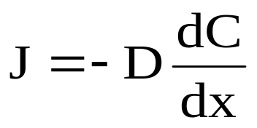
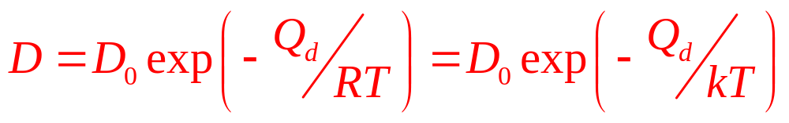
Diffusion – Temperature Dependence
Diffusion coefficient is the measure of mobility of diffusing species.
D₀ – temperature-independent (m²/s)
Q_{d} – the activation energy (J/mol or eV/atom)
R – the gas constant (8.31 J/mol-K)
or
k_{B} - Boltzman constant ( 8.62×10⁻⁵ eV/atom-K)
T – absolute temperature (K)

Slide 20
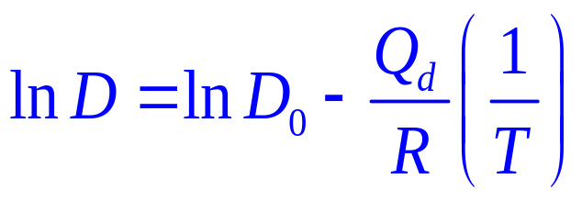
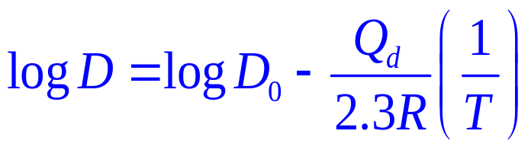
or
Arrhenius Plots
(lnD) vs. (1/T) or (logD) vs. (1/T)

Slide 21
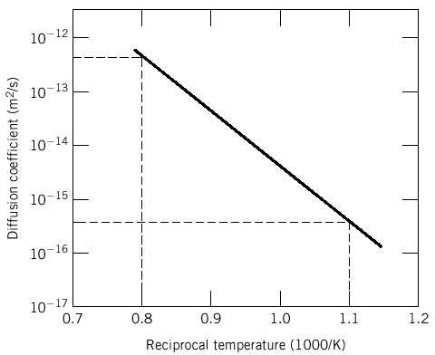
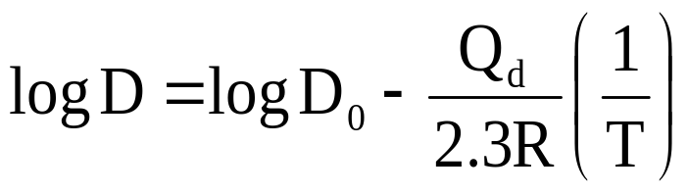
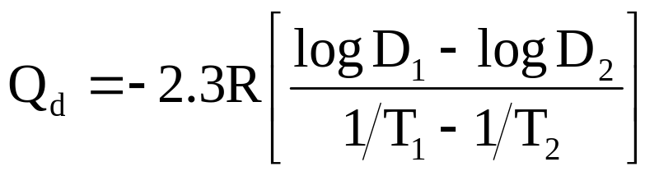
Graph of log D vs. 1/T has slop of –Q_{d}/2.3R,
intercept of log D_{o}

Slide 22
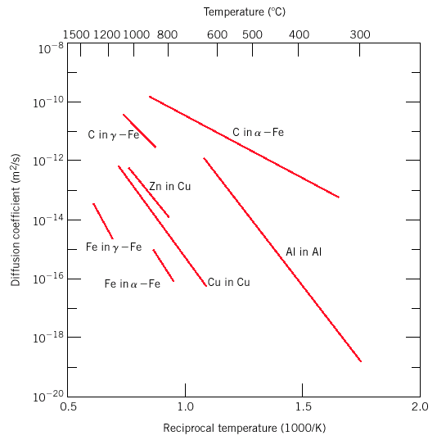
Arrhenius plot:
Diffusivity for metallic systems

Slide 23
5.21
The diffusivity coefficient for nickel in iron are given at two temperatures:
(a) Determine the values of the constant D₀ and the activation
energy Q_{d}.
(b) What is the magnitude of D at 1300℃ (1573 K)?
T(K) | D(m²/s)
1473 | 2.2x10⁻¹⁵
1673 | 4.8x10⁻¹⁴

Slide 24
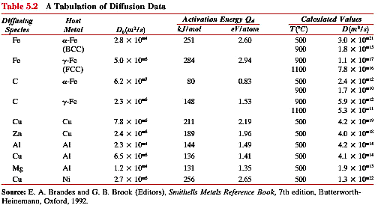
Smaller atoms diffuse more readily

Slide 25
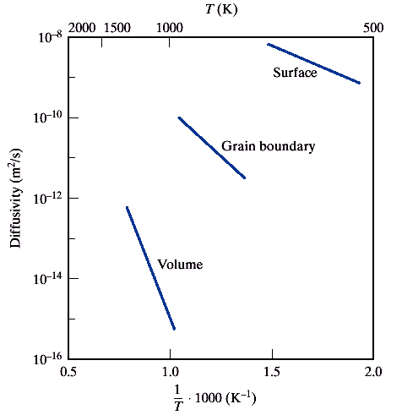
Diffusion: Role of the microstructure
Self-diffusion coefficients for Ag
Depends on diffusion path
Grain boundaries and surfaces less restrictive

Slide 26
Factors that Influence Diffusion
Temperature - diffusion rate increases very rapidly with increasing temperature
Diffusion mechanism - interstitial is usually faster than vacancy
Diffusing and host species - D_{o}, Q_{d} is different for every solute, solvent pair
Microstructure - diffusion faster in polycrystalline vs. single crystal materials because of the rapid diffusion along grain boundaries and dislocation cores.

Slide 27
Nitrogen from a gaseous phase is to be diffused into pure iron at 700℃. If the surface concentration is maintained at 0.1 wt％ N, what will be the concentration 1 mm from the surface after 10 h? The diffusion coefficient for nitrogen in iron at 700℃ is 2.5 × 10⁻¹¹ m²/s.

